Slide 1
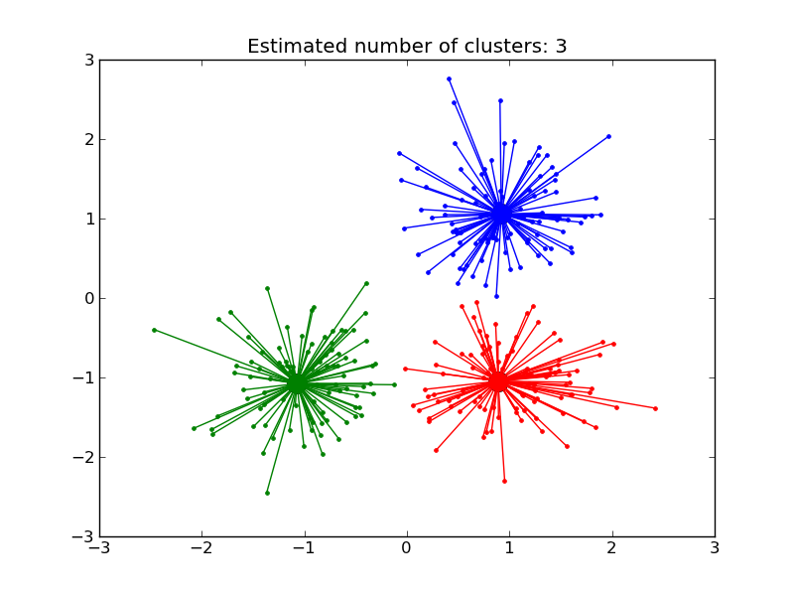
AFFINITY PROPAGATION
What is Affinity Propagation?
Affinity propagation is a clustering algorithm that is commonly used in machine learning and data analysis
Affinity propagation is based on the concept of “message-passing” between data points to primarily functioning on the idea of identifying exemplary points (also known as "exemplars") within a dataset rather than requiring a pre-defined number of clusters

Slide 2
KEY CONCEPT OF AFFINITY PROPAGATION
EXEMPLARS:
These are the representative points or “centroids” of clusters. The algorithm identifies which data points are the best representatives (exemplars) of the clusters.
MESSAGE:
Affinity Propagation works by passing two types of messages between data points through (Responsibility and Availability).

Slide 3
KEY CONCEPT OF AFFINITY PROPAGATION
RESPONSIBILITY
In the context of Affinity Propagation (AP), the term responsibility refers to a message sent from one data point (called a candidate exemplar) to another data point (called a potential exemplar) indicating how well the potential exemplar represents the candidate point in a cluster. It is part of the iterative process that helps determine which data points will ultimately be selected as exemplars (the central points of clusters).
AVAILABILITY
In Affinity Propagation (AP), availability is another key message passed between data points that plays an important role in determining the final cluster assignments and selecting exemplars (the representative points for clusters). While responsibility tells a data point how well it fits as a member of a potential exemplar's cluster, availability indicates how appropriate it is for a data point to choose a particular point as its exemplar.

Slide 4
ADVANTAGE
Does not require specifying the number of clusters.
Can find clusters of various shapes and sizes.
Works well with large datasets and datasets where clusters are not well-separated.

Slide 5
DISADVANTAGE
Computationally Expensive
The algorithm has a higher computational cost than simpler clustering algorithms. like K-means, especially for large datasets.
Memory intensive
The need to maintain a similarity matrix for all pairs of points can be memory-intensive

Slide 6
USE CASE
Used in various fields:
  Image segmentation
  Document clustering
  Bioinformatics
  Social network analysis

